Slide 1
Introduction to Machine Learning

Slide 2
What is Machine Learning
A subset of Artificial Intelligence that enables systems to learn from data and improve without being explicitly programmed. Think of it as teaching a computer to recognize patterns and make decisions on its own.
According to Tom Mitchell, ML is the study of algorithms that:
Improves performance P
At some task T
With experience P
A well-defined learning task is given by <P,T,E>

Slide 3
History of Machine Learning
1950s : Turing Test (1950), Perceptron (1957)
1960s : Nearest Neighbor (1967), AI Winter begins (1969)
1980s : Backpropagation (1986), Rise of Neural Networks
1990s : SVM, Ensemble Learning
2000s : ML in Search, ads and Recommendations (Netflix 2006)
2010s : Deep Learning Boom (2012), GANs (2014), BERT (2018)
2020s : Foundation Models like ChatGPT & Gemini, Multimodal AI, Ethical AI

Slide 4
When Do We Use ML
ML is used when:
Human Expertise doesn’t exist. Ex- Navigating on Mars.
Human can’t explain their expertise. Ex- Speech Recognition.
Human in need of a companion. Ex- Chatbots, NLP.
Complexity of work is so high. Ex- Maintaining records of company, finding something unique in data.

Slide 5
Benefits of Machine Learning
Automation of Repetitive and Time-Consuming Tasks. Ex- Email Filtering
Better Decision Making in Large Datasets. Ex- Financial Forecasting
Personalized Recommendation to User. Ex- Amazon Product Suggestion
Faster and More Accurate Predictions. Ex- Weather Forecasting.
Enhanced Security. Ex- Credit Card Fraud Alerts
Solving Complex Problems. Ex- NLP, Voice Recognition
Advancement in Healthcare and Science. Ex- Detect Cancer from medical images,
Enabling Smart Devices. Ex- Alexa, Tesla Autopilot

Slide 6
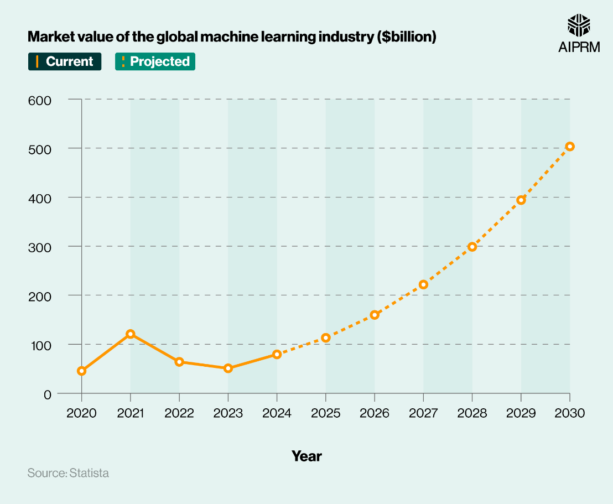
Current Status of ML Market
According to Statista, the machine learning market is projected to reach $113.10 billion in 2025 and continue growing to $503.40 billion by 2030, with a CAGR of 34.80%.
Many organizations are actively adopting machine learning, with some already seeing significant benefits in terms of productivity and revenue, like Healthcare, Finance, Agriculture, etc.
Current Trends:
Foundation Models
Edge AI
ML + Cybersecurity
ML in Automobiles
g

Slide 7








How Machine Learning Works
Data Collection
Training Algorithms
ML systems rely on large volumes of structured or unstructured data, gathered from diverse sources to create comprehensive datasets.
Algorithms identify patterns and relationships in the collected data, iteratively adjusting to minimise errors and improve performance.
Prediction & Decision-Making
Continuous Improvement
ML models are constantly refined as new data becomes available, ensuring they adapt and enhance their accuracy over time.
Once trained, ML models can make accurate predictions or automate decisions based on new, unseen data, driving efficiency and insights.

Slide 8
Key Types of Machine Learning
1.
Supervised Learning
Learns from labelled data, where the output is known (e.g., classifying emails as spam or not spam). This is like learning with a teacher.
2.
Unsupervised Learning
Finds hidden patterns or structures in unlabelled data (e.g., segmenting customers into distinct groups based on purchasing behaviour). This is learning without a teacher.
3.
Reinforcement Learning
Learns through trial and error by interacting with an environment and receiving rewards or penalties (e.g., training a robot to navigate a maze or playing complex games). This is learning by doing.

Slide 9





Real-World Applications of ML across Industries
Healthcare
Predicting diseases from medical images, personalising treatment plans, and accelerating drug discovery processes.
Finance
Detecting fraudulent transactions, optimising algorithmic trading strategies, and providing personalised financial advice.
Agriculture
Predicting crop yields, detecting pests and diseases early, and optimizing irrigation and fertilization for sustainable farming.
Governance
Enabling smart city planning, simulating policy outcomes, and enhancing public service delivery through data-driven insights.
Education
Developing adaptive learning systems tailored to individual student needs, automating grading, and providing predictive analytics for student success.

Slide 10
Hardware Requirements of ML
Actually, It depends.
If you are a beginner and want to learn ML, a basic 4GB Ram Desktop, Laptop, or even a Mobile phone can be used, but usually small and text-based datasets are used.
But if you want to build a proper project, perform data analysis and create some models (like CNN, NLP models) on huge dataset:
RAM : At least 8GB DDR5 (16GB Recommended)
CPU : Intel i5 12th Gen (i7 Recommended)
Storage : 256-512GB SSD Storage
GPU : 4-6GB DDR5 (NVIDIA GPU with CUDA like GTX 1660, RTX 2060)
But for actual production level (like training LLMs, Custom Object Detection):
RAM : 32-64GB RAM
CPU : Intel i7 or i9 Processor
Storage : 1TB SSD Storage
GPU : NVIDIA RTX 3080 or above.

Slide 11
Requirements to Learn ML
1. Mathematics:
Linear Algebra, Calculus, Probability & Statistics, Optimization.
2. Programming:
Language - Python
Libraries - NumPy, Pandas, Matplotlib
3. Tools and Frameworks:
scikit-learn – Basic ML
TensorFlow/PyTorch – Deep Learning
Seaborn, Plotly – Visualization
4. Data Handling:
Data Cleaning, Preprocessing, Feature Engineering, Splitting Data.
5. Core ML Concepts:
Supervised and Unsupervised Learning
Evaluation Metrics (Accuracy, F1, ROC-AUC)
Overfitting and Underfitting
Cross Validation

Slide 12
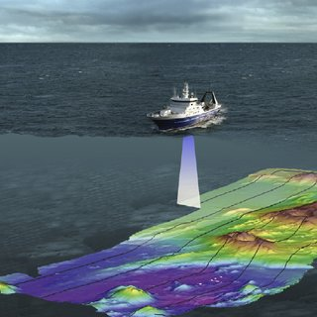
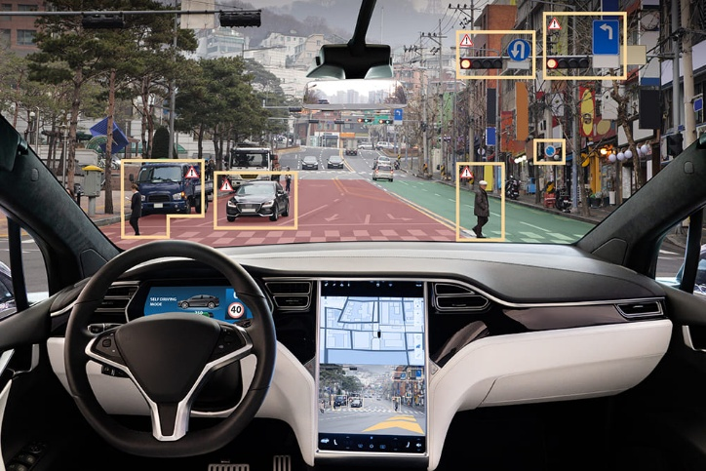
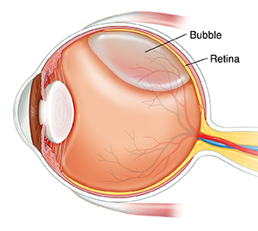
Real World Examples
SONAR Systems
Eye Retina
Self Driving Cars
Difference in Salinity, Temperature and Pressure of water can affect the speed of sound in water.
So, algorithms like Logistic Regression, SVM or CNN can be used for proper classification.
IKITES developed a Model which can detect Drusen, GA, etc. like problems in Eye Retinas using Deep Learning by analyzing OCT scans of Anterior Basement Membrane (ABM) of Eye.
Tesla developed its system called Autopilot, which recognizes traffic signs, and makes decisions using Computer Vision and Reinforcement Learning.

Slide 13
Conclusion
Machine Learning is shaping the future of humanity.
It gives us an opportunity to innovate across sectors.
Its success depends on the data quality, ethical use, and domain integration.
The real power of ML is not replacing humans, but in augmenting human potential.

